Slide 1




Travel Blog Website

Slide 2

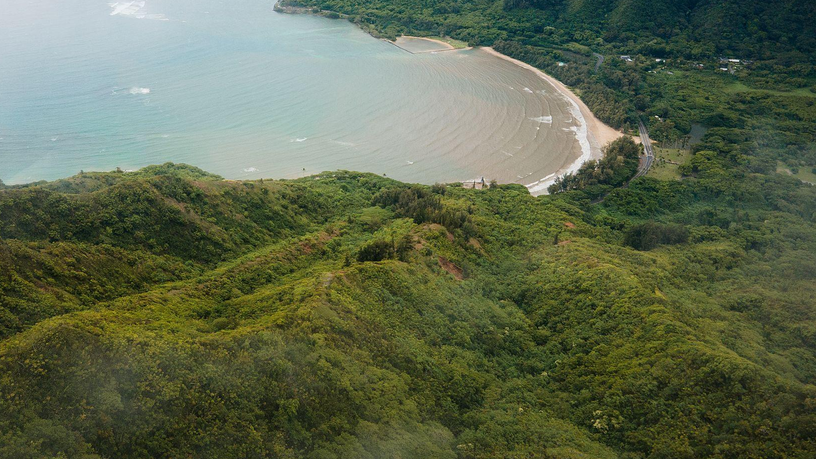

Introduction
Project Overview:
The Travel Blog website is a platform designed for users to explore and share travel experiences. It allows users to read blog posts, search for specific travel stories, create personal profiles, and register/login to interact with the platform.
Goal:
The main goal of this project is to provide a user-friendly, interactive platform where travel enthusiasts can share their journeys and readers can easily search and find relevant content..

Slide 3

Project Architecture
Frontend Technologies:
The website is built using HTML, CSS, JavaScript, and Angular. It incorporates responsive design techniques to ensure a smooth experience across devices.

Slide 4
Website Pages Overview:
Sign Up/Log In Page:
Home page:
Handles user authentication and account management.
Serves as the entry point, featuring a welcome message and links to key sections like the Blog and Profile
Blog page:
User profile page:
Displays a list of posts with a search bar for filtering content based on keywords.
Allows users to view and edit personal details and see their previously published posts.

Slide 5
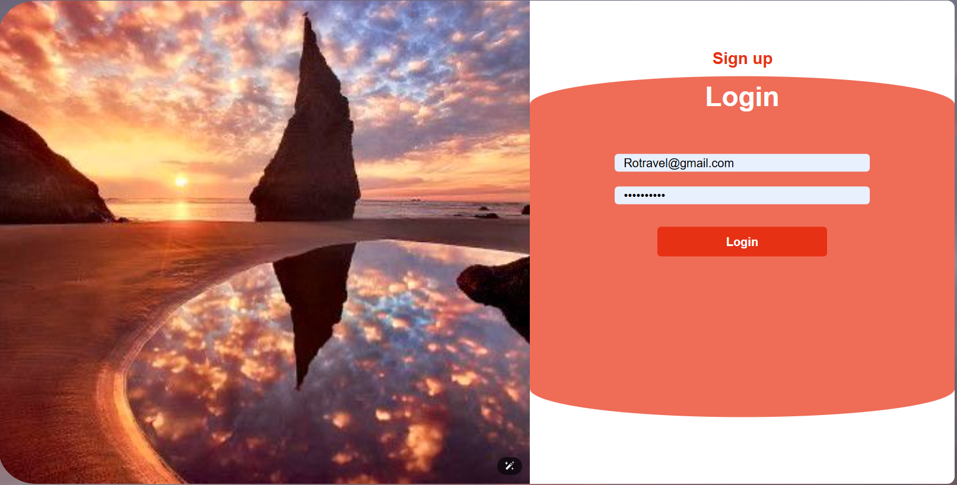
Sign Up/Log In Page Features
New users can create an account by providing a username, email, and password. Form validation ensures that correct data formats are submitted.

Slide 6
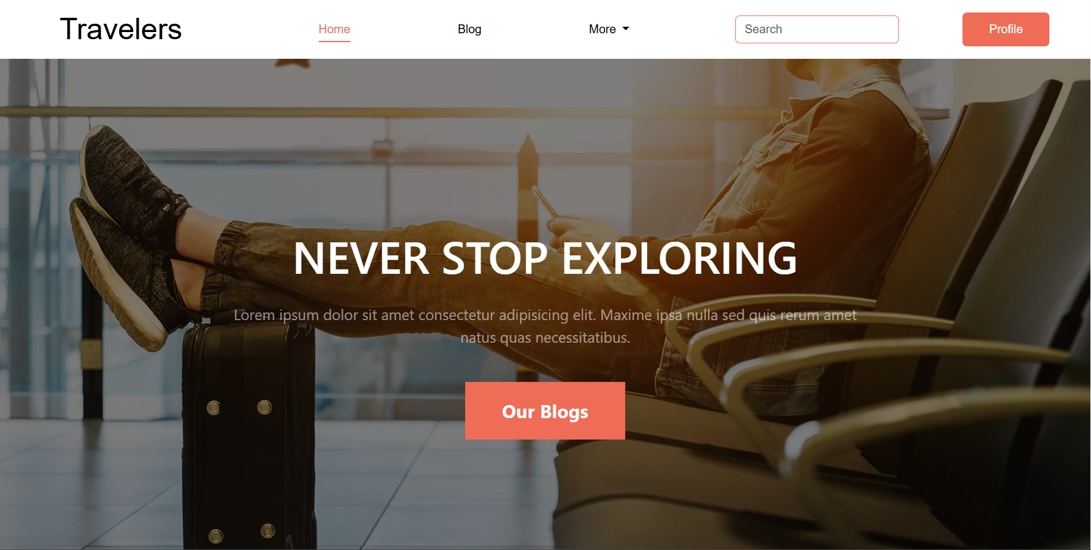
Home Page Features
Navigation bar to access other pages (Blog, Profile, Sign up/Log in).
Featured blog posts with images and brief descriptions.
Design Considerations:
Clear and minimalistic layout to make navigation simple.
Responsive design ensures smooth transitions across desktop and mobile devices.

Slide 7
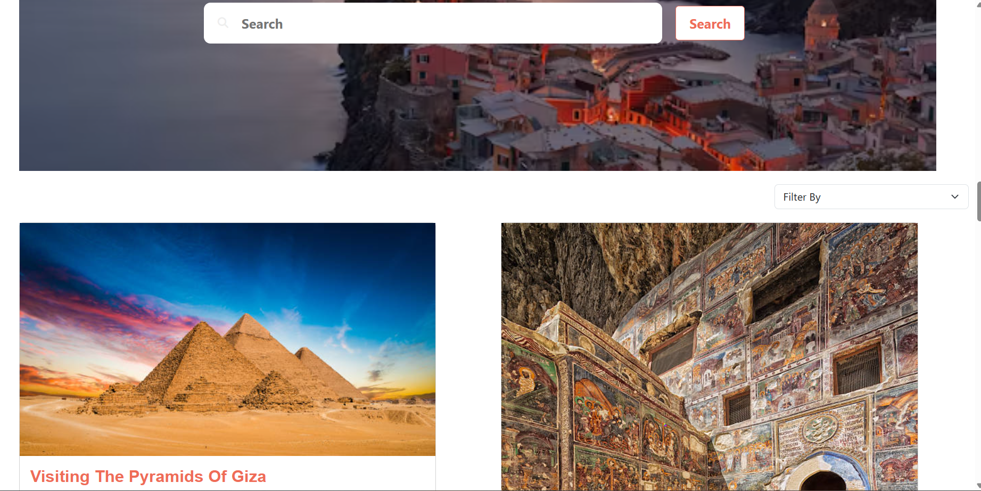
Blog Page Features:
Key Features:
A list of blog posts, each containing a title, image, author, and content excerpt.
A Search Bar at the top of the page allows users to filter blog posts by keywords, making it easier to find relevant articles.
Post Structure:
Each post includes:
Title: The name of the blog post.
Content: A brief description or travel story.
Author: The name of the post creator.
Date and Tags: Meta information related to the post.

Slide 8
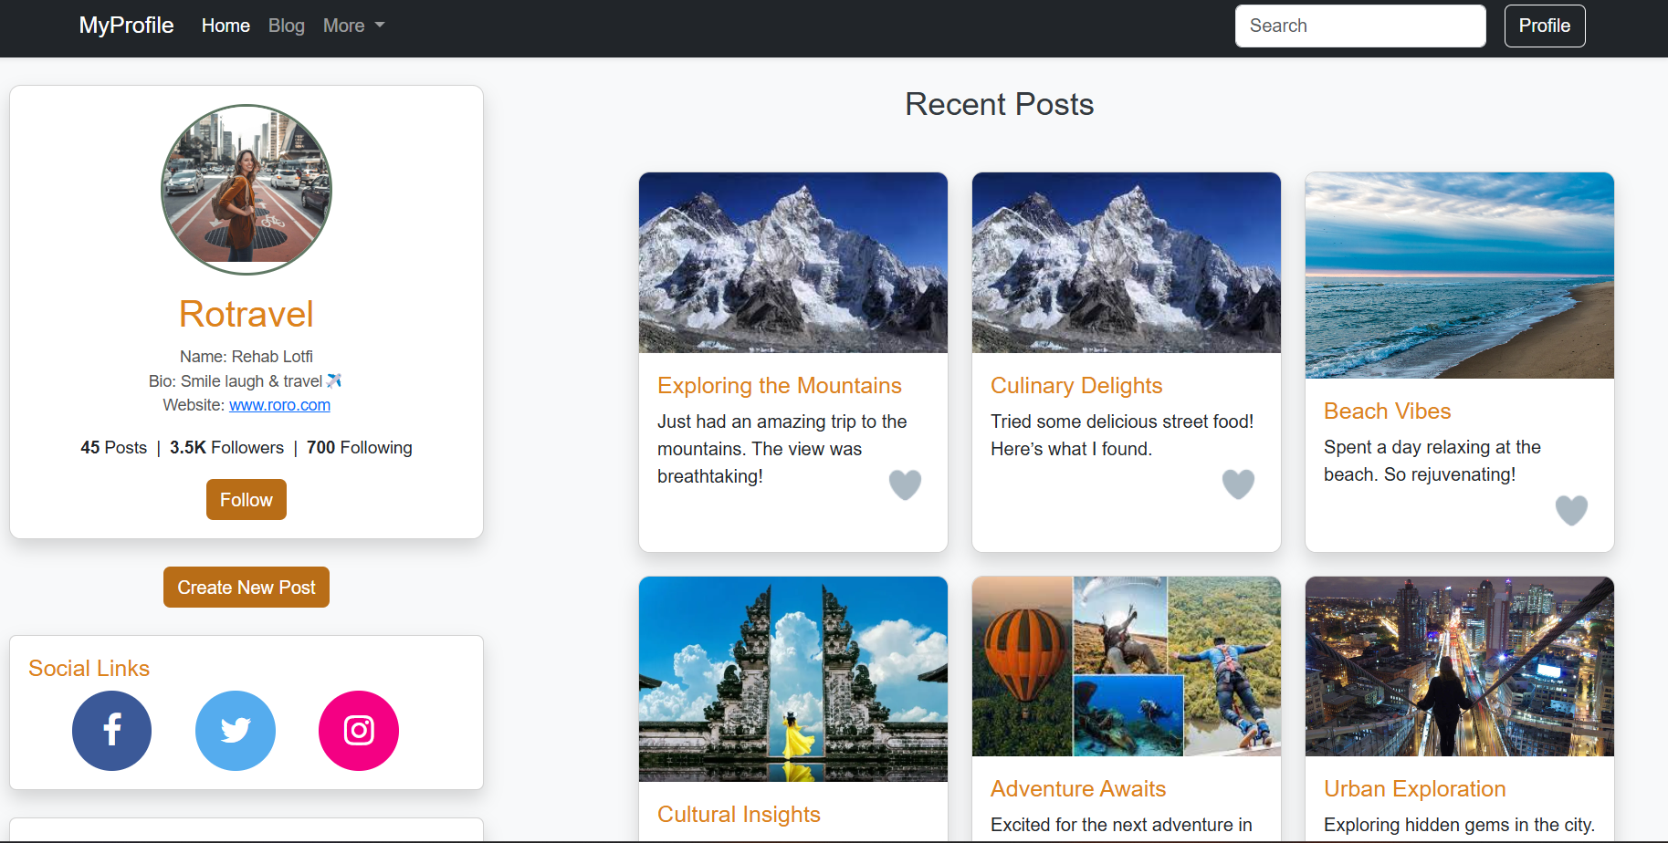
User Profile Page
Key Features:
Displays user's name, bio, and profile picture.
A list of the user's published blog posts, with options to view or edit each post.
Edit functionality to allow users to update their bio and other profile information.
User Interaction:
Users can view their activity and manage personal information easily.

Slide 9

Conclusion
The Travel Blog website provides a seamless experience for users to share and discover travel stories. The project showcases key frontend development skills such as responsive design, interactive UI elements, and user authentication.

Slide 10
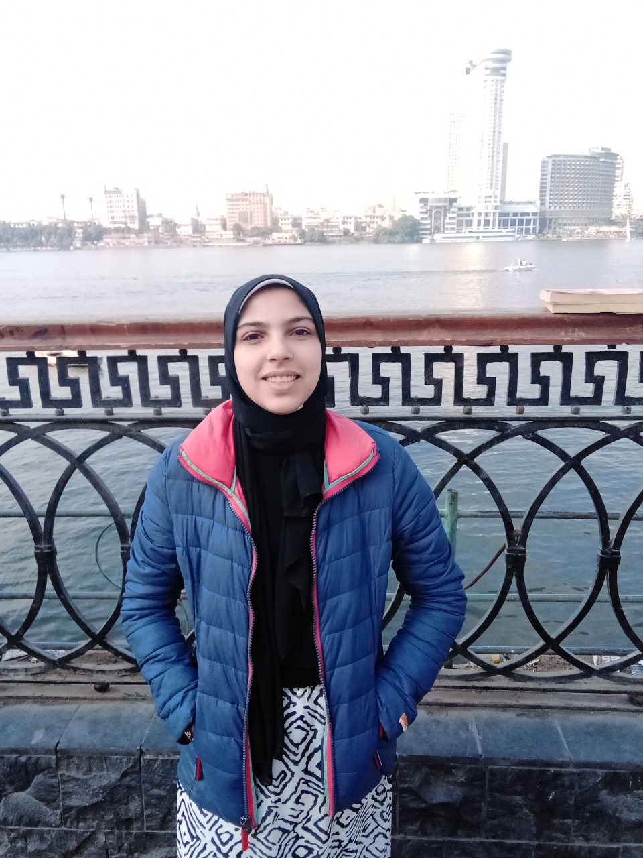
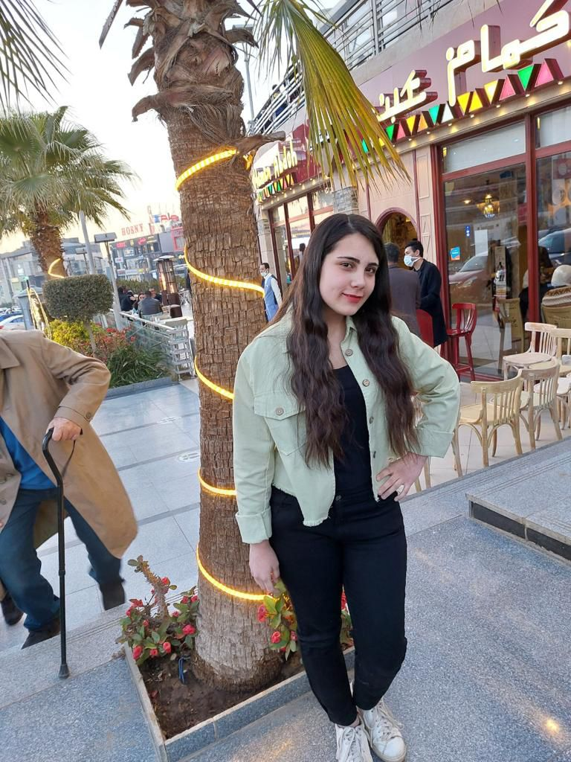
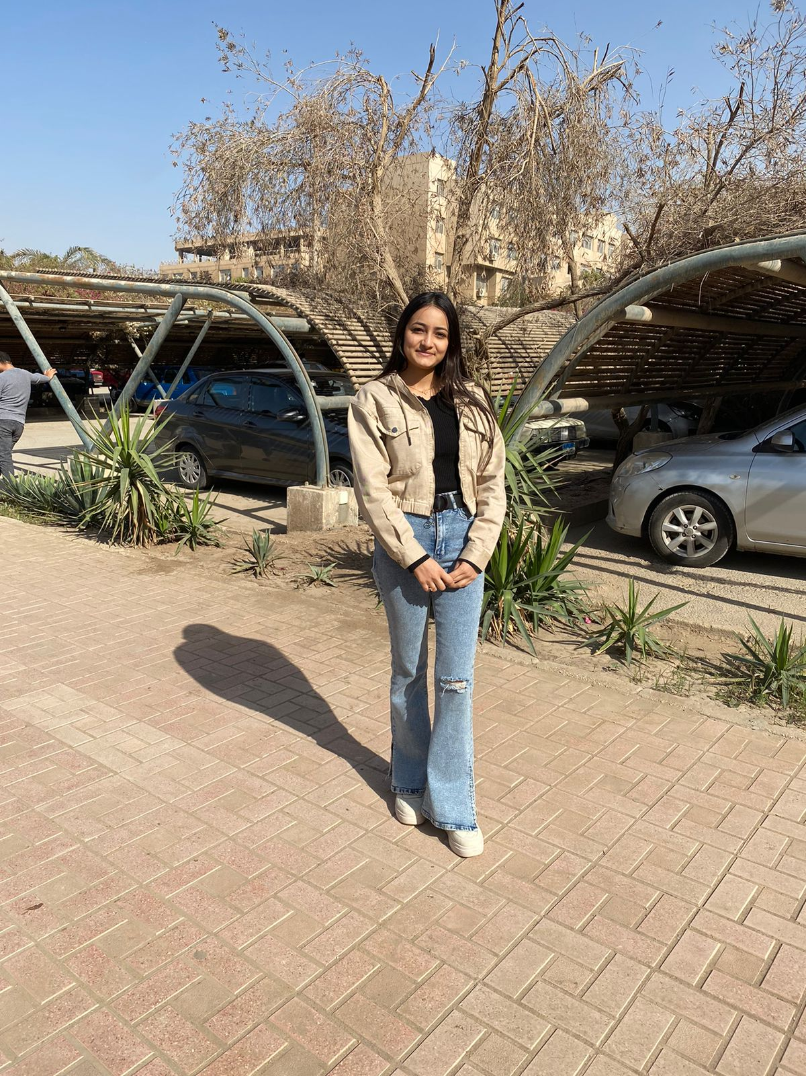


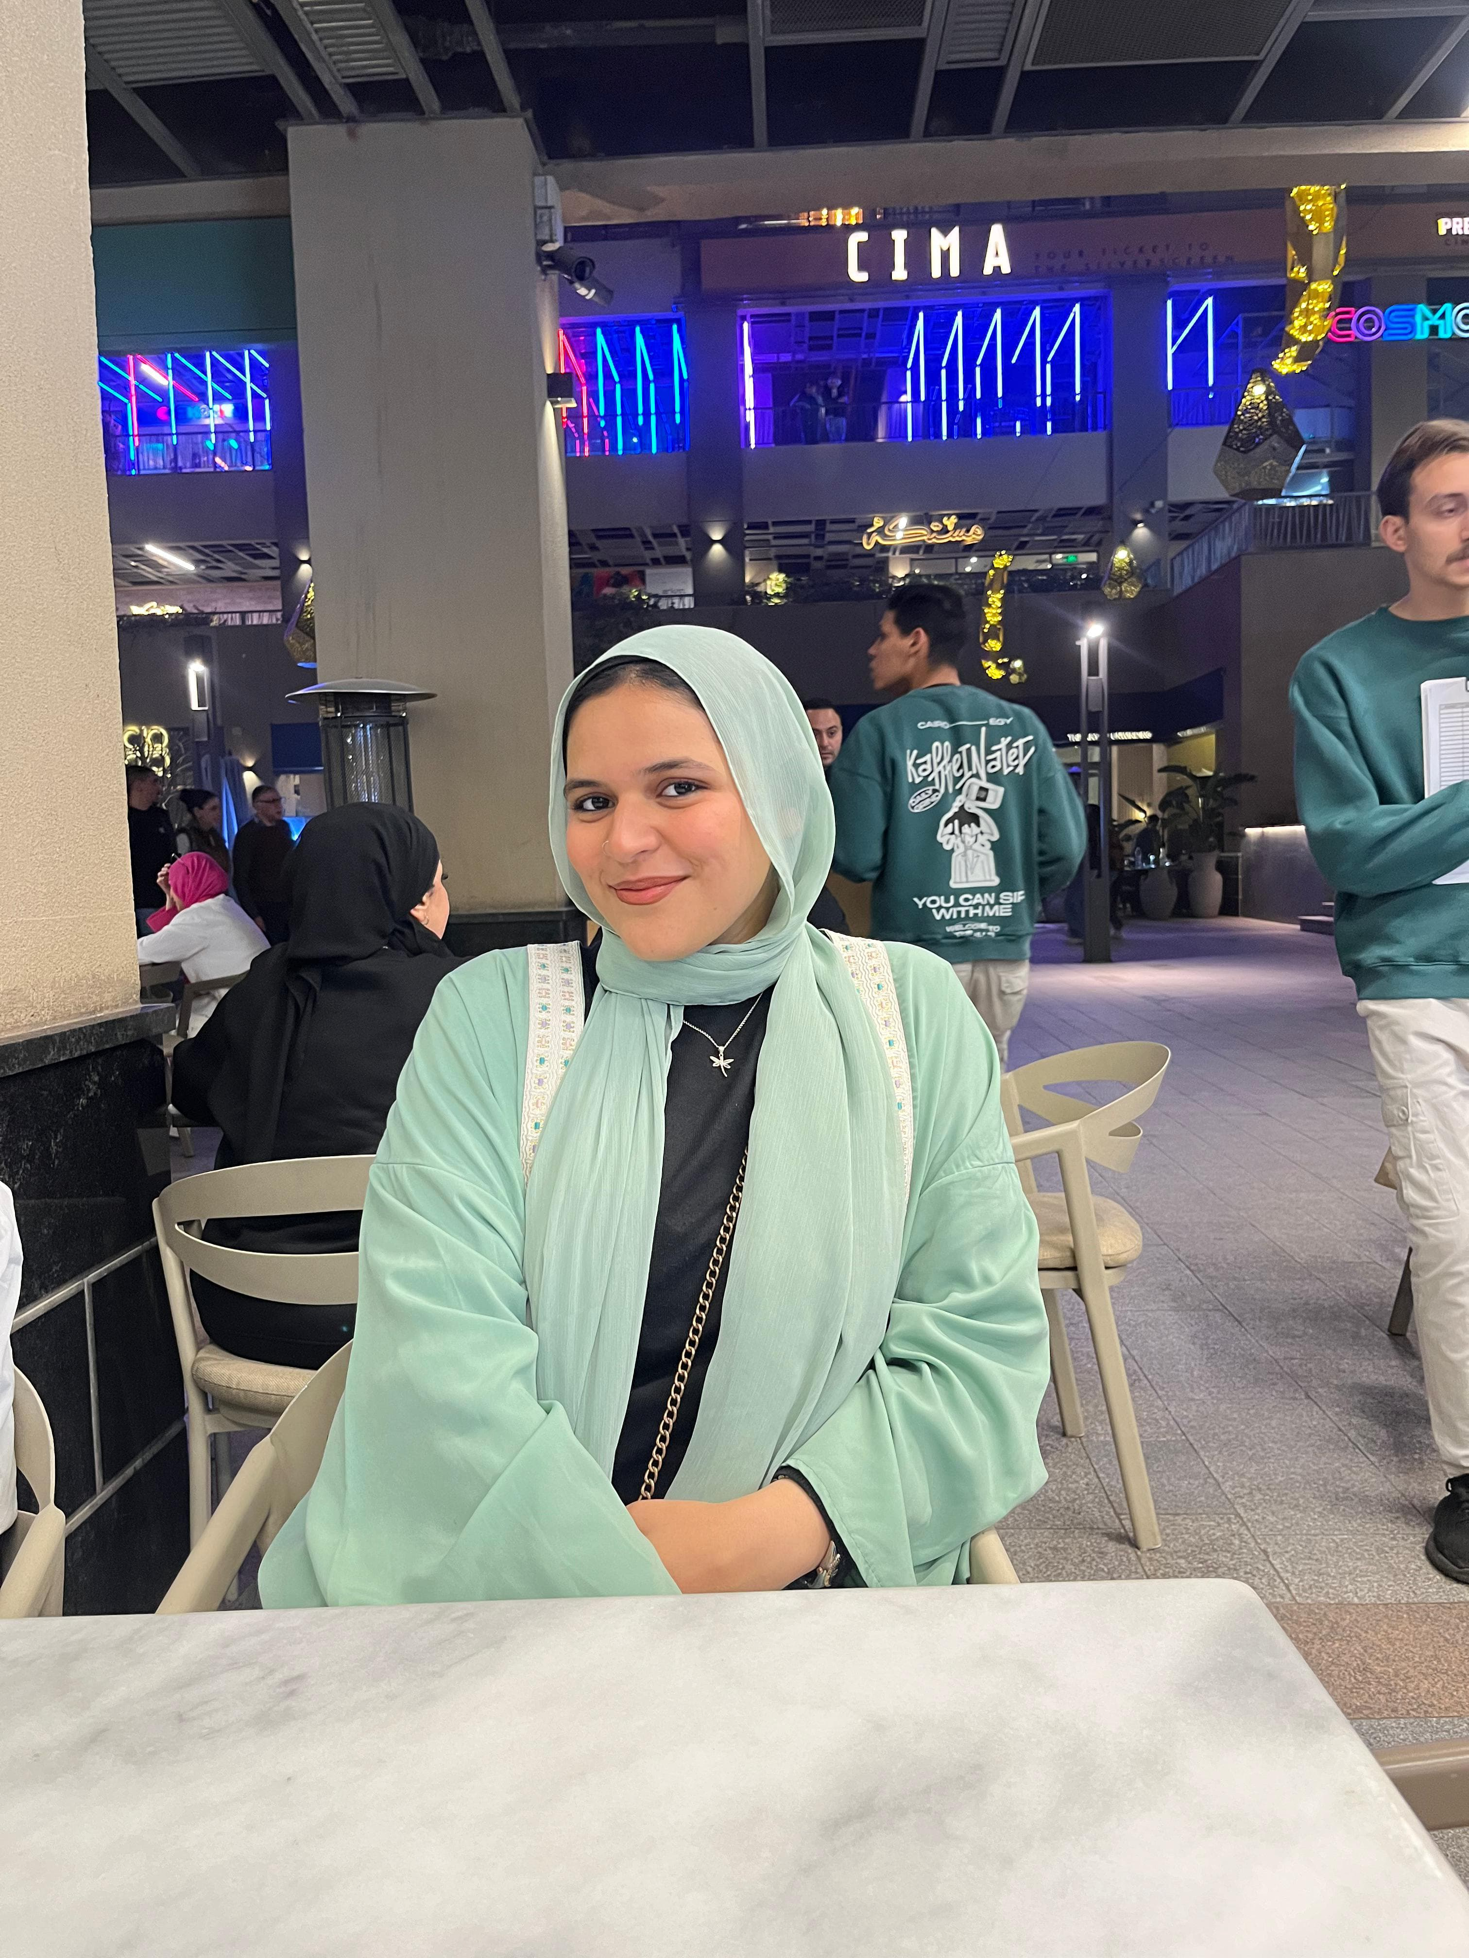
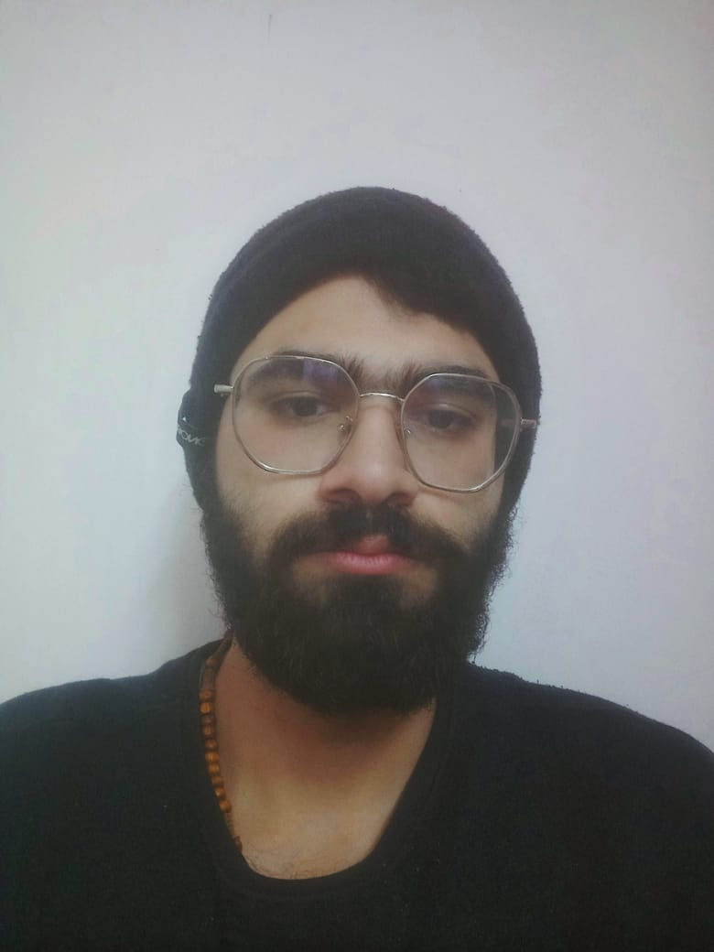
OUR TEAM
Toka kram
Jana Mohamed
Nancy Adel
Marwan Ahmed
Sara Elyash
Rodina Yehia
Mina Adly

Slide 11

THANKS!

